Slide 1

https://www.youtube.com/watch?v=SqqmuJRSM4Q&list=PLUJOuapA83-QlWbnMJvoyQucGaBlpBF0F&index=28

Slide 2
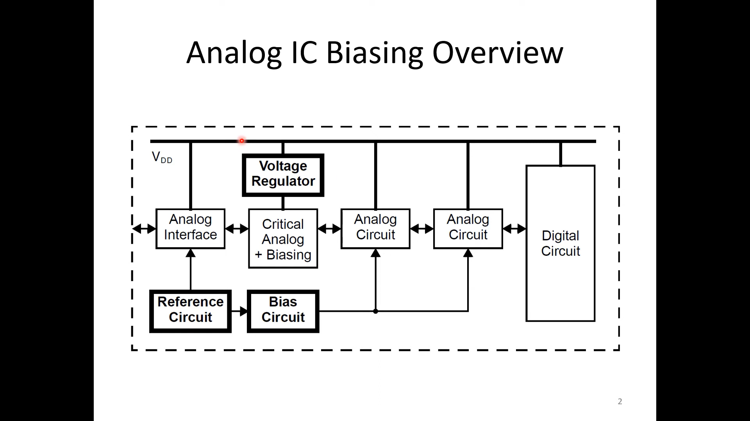

Slide 3
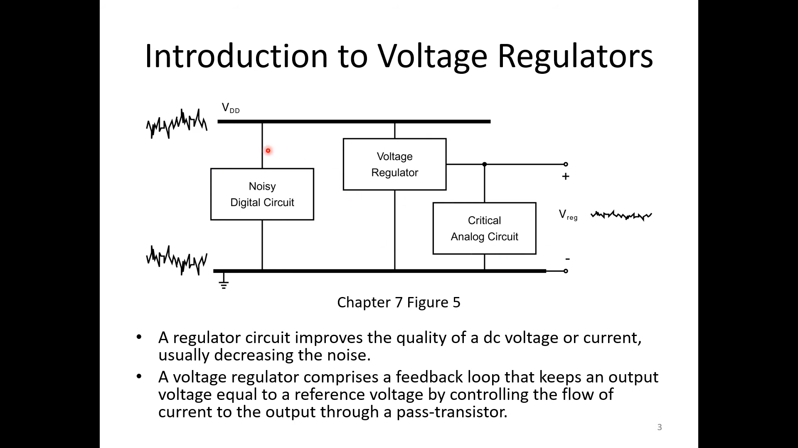

Slide 4
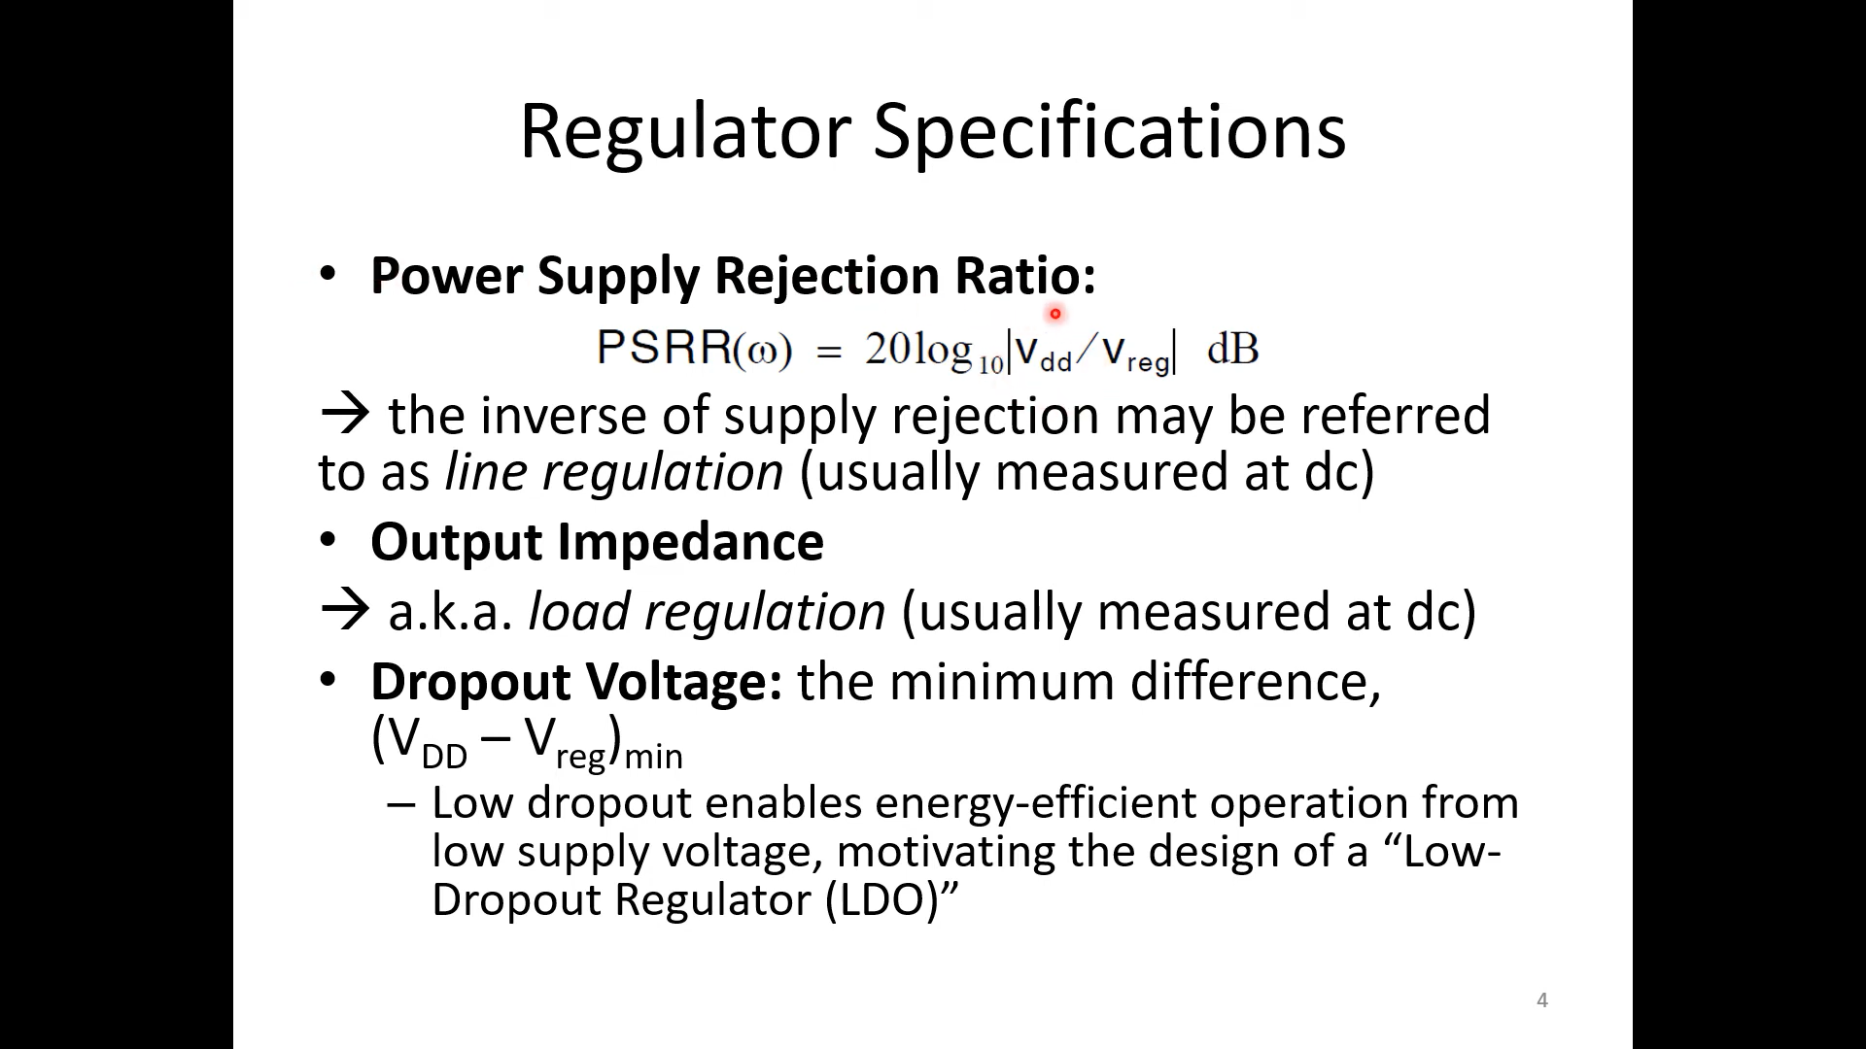

Slide 5
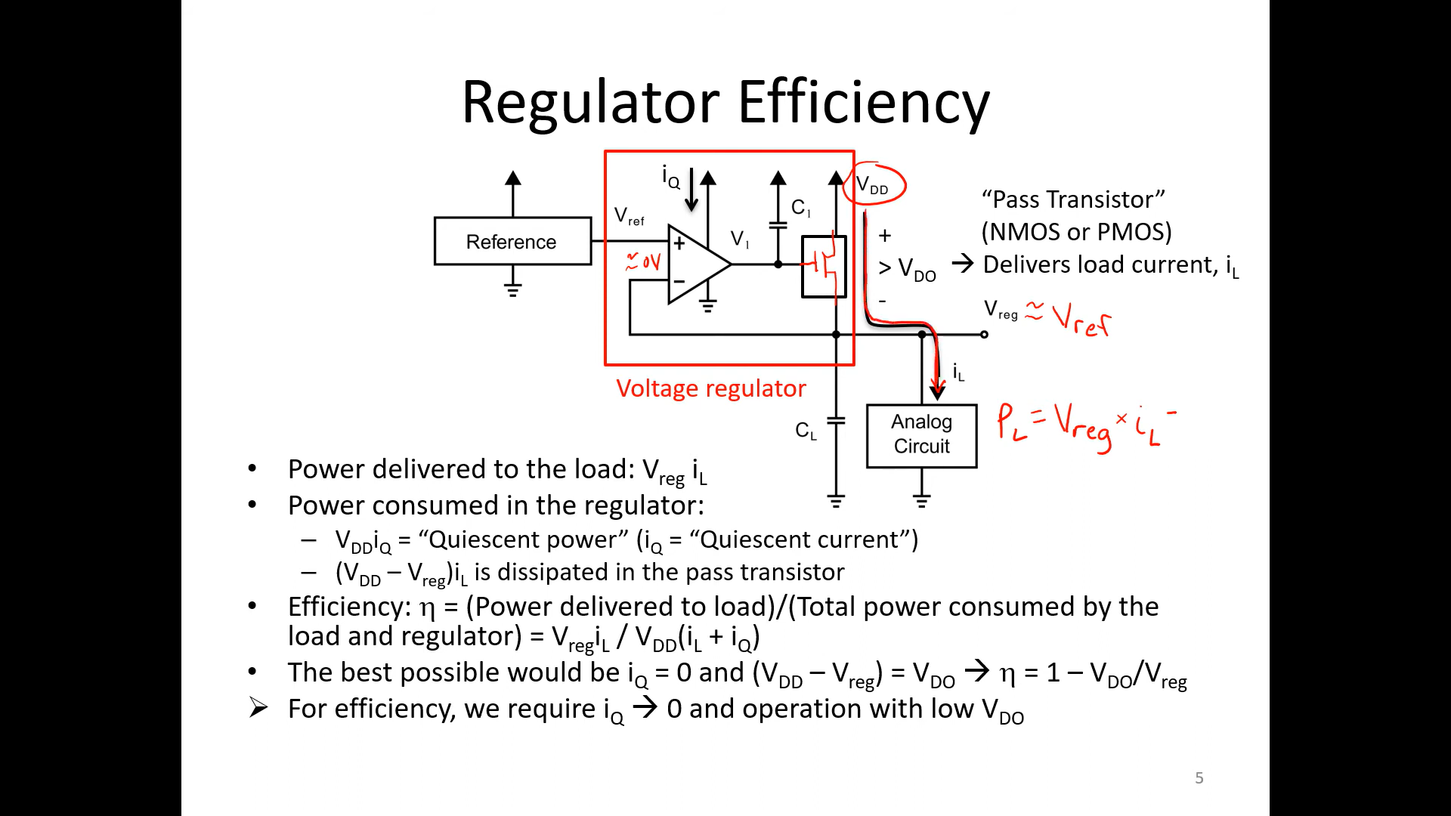

Slide 6
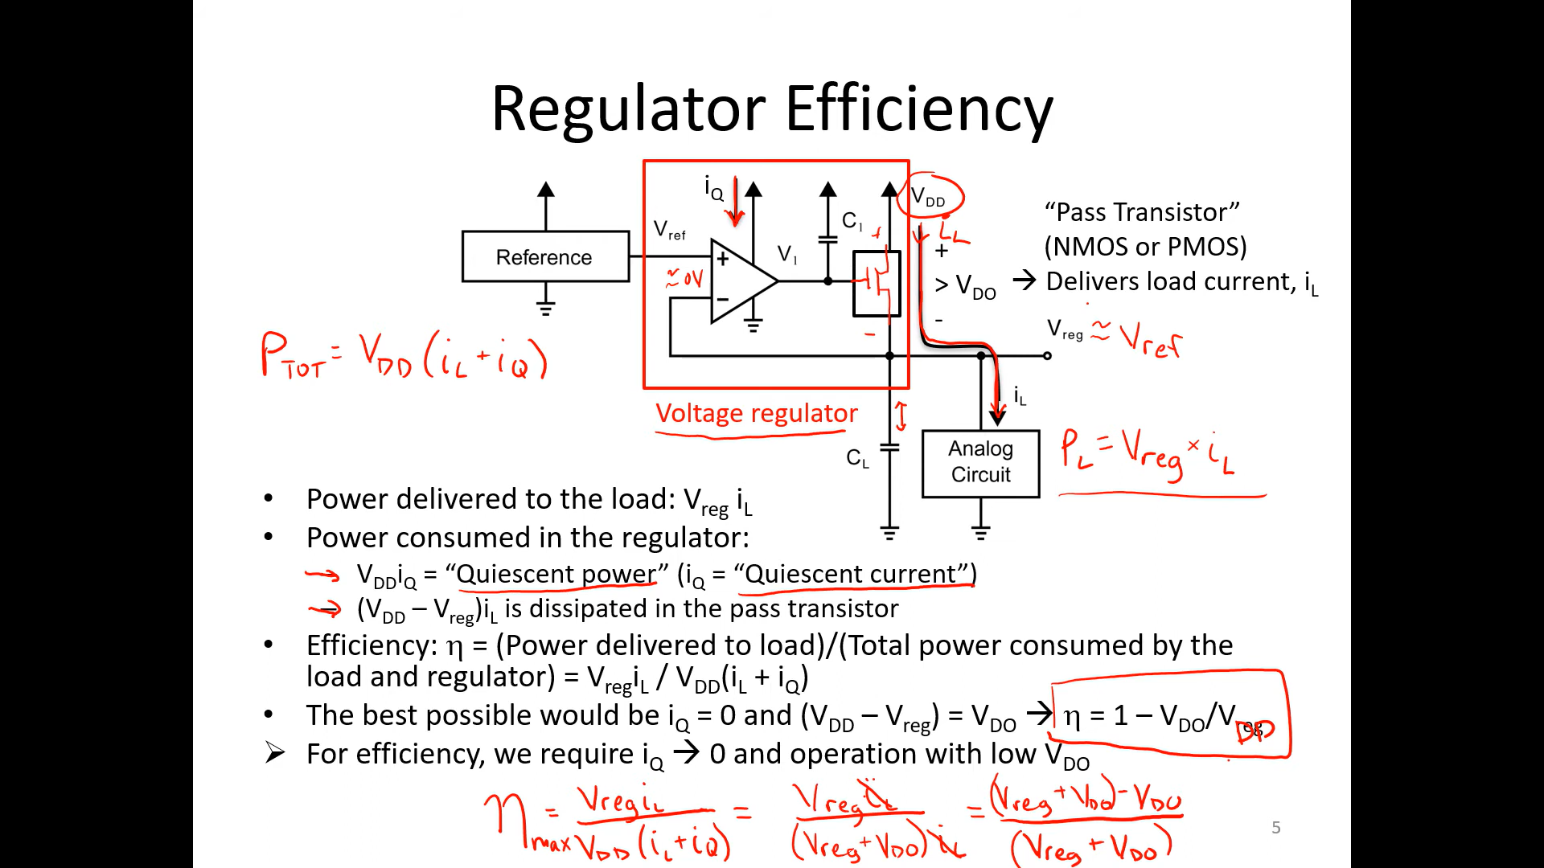

Slide 7
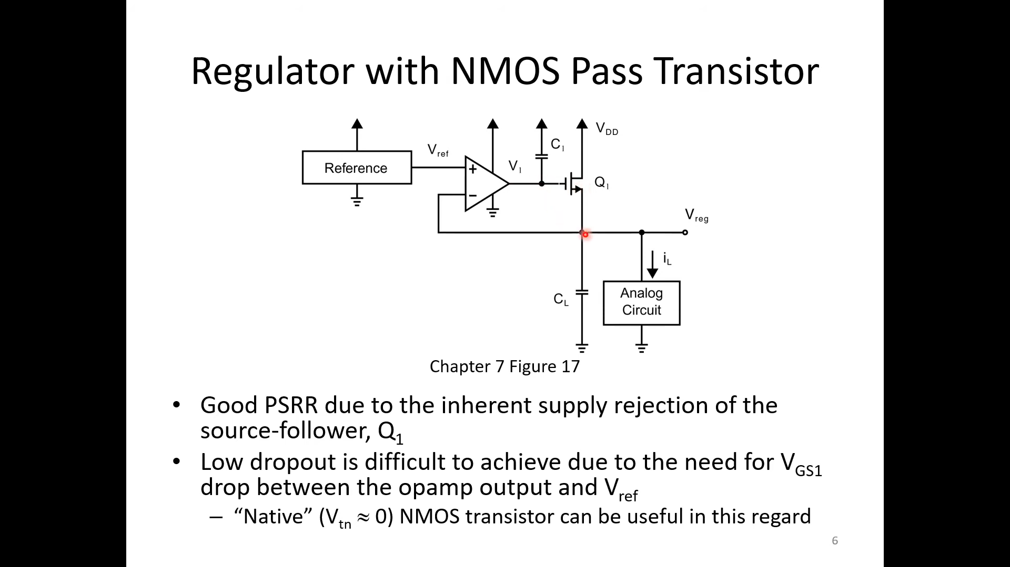
CL may be desired to be large to supply the spike currents (decap).
This would make the output the dominant pole.

Slide 8
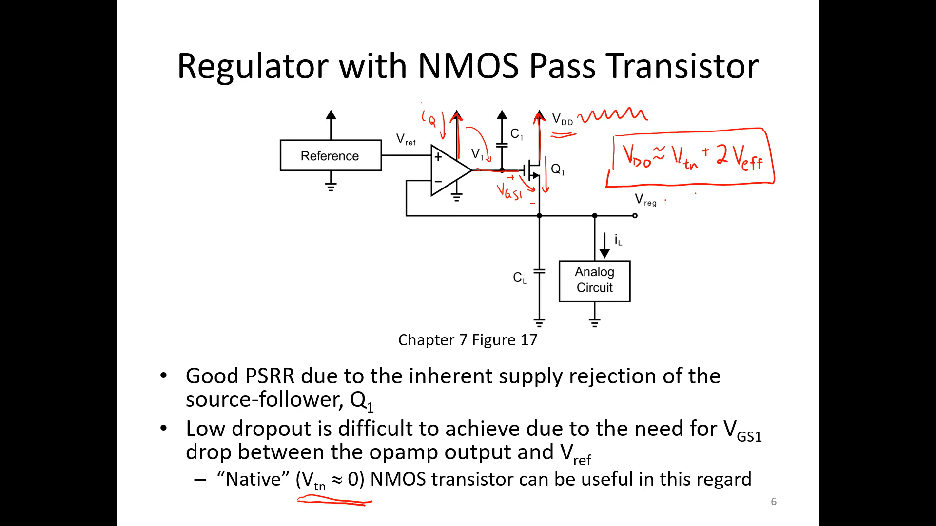

Slide 9
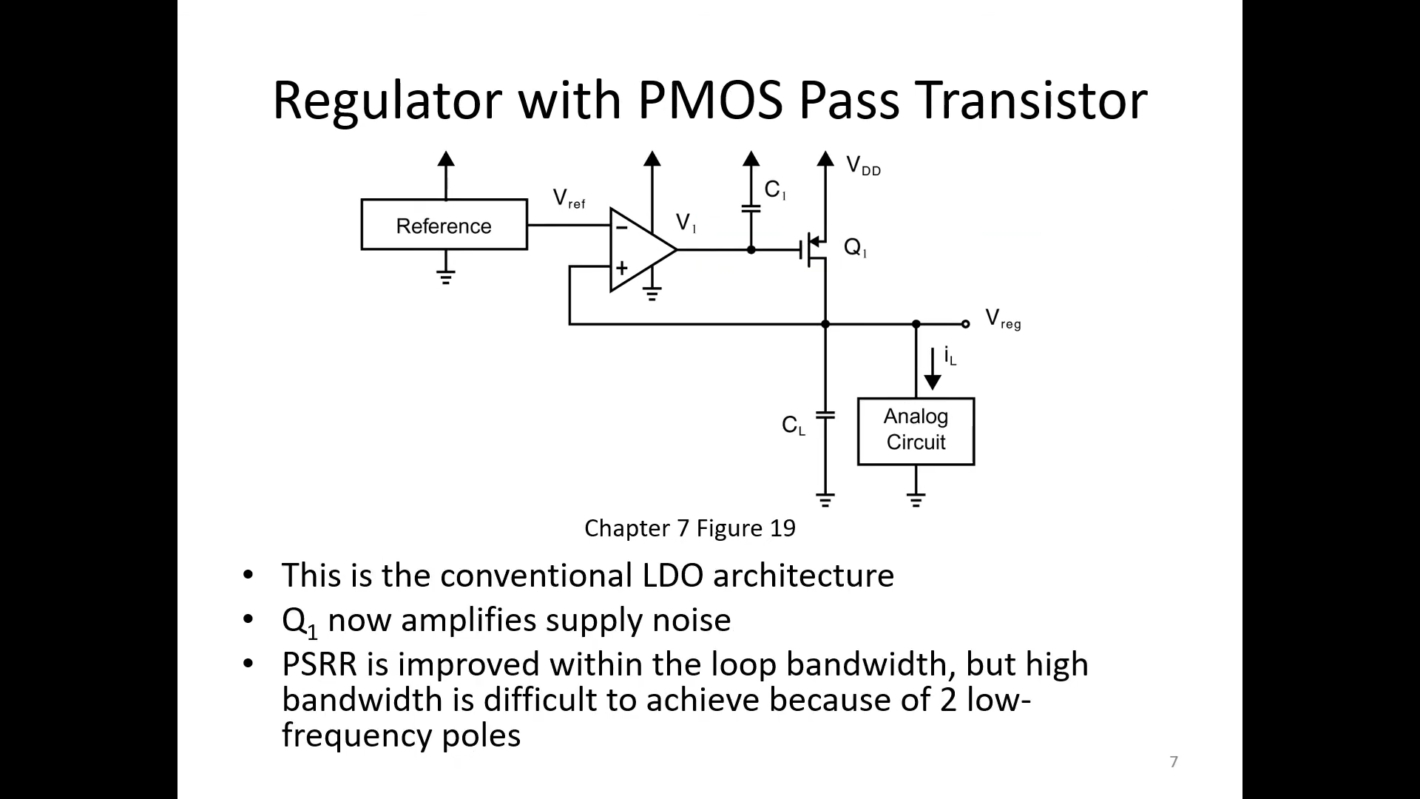

Slide 10
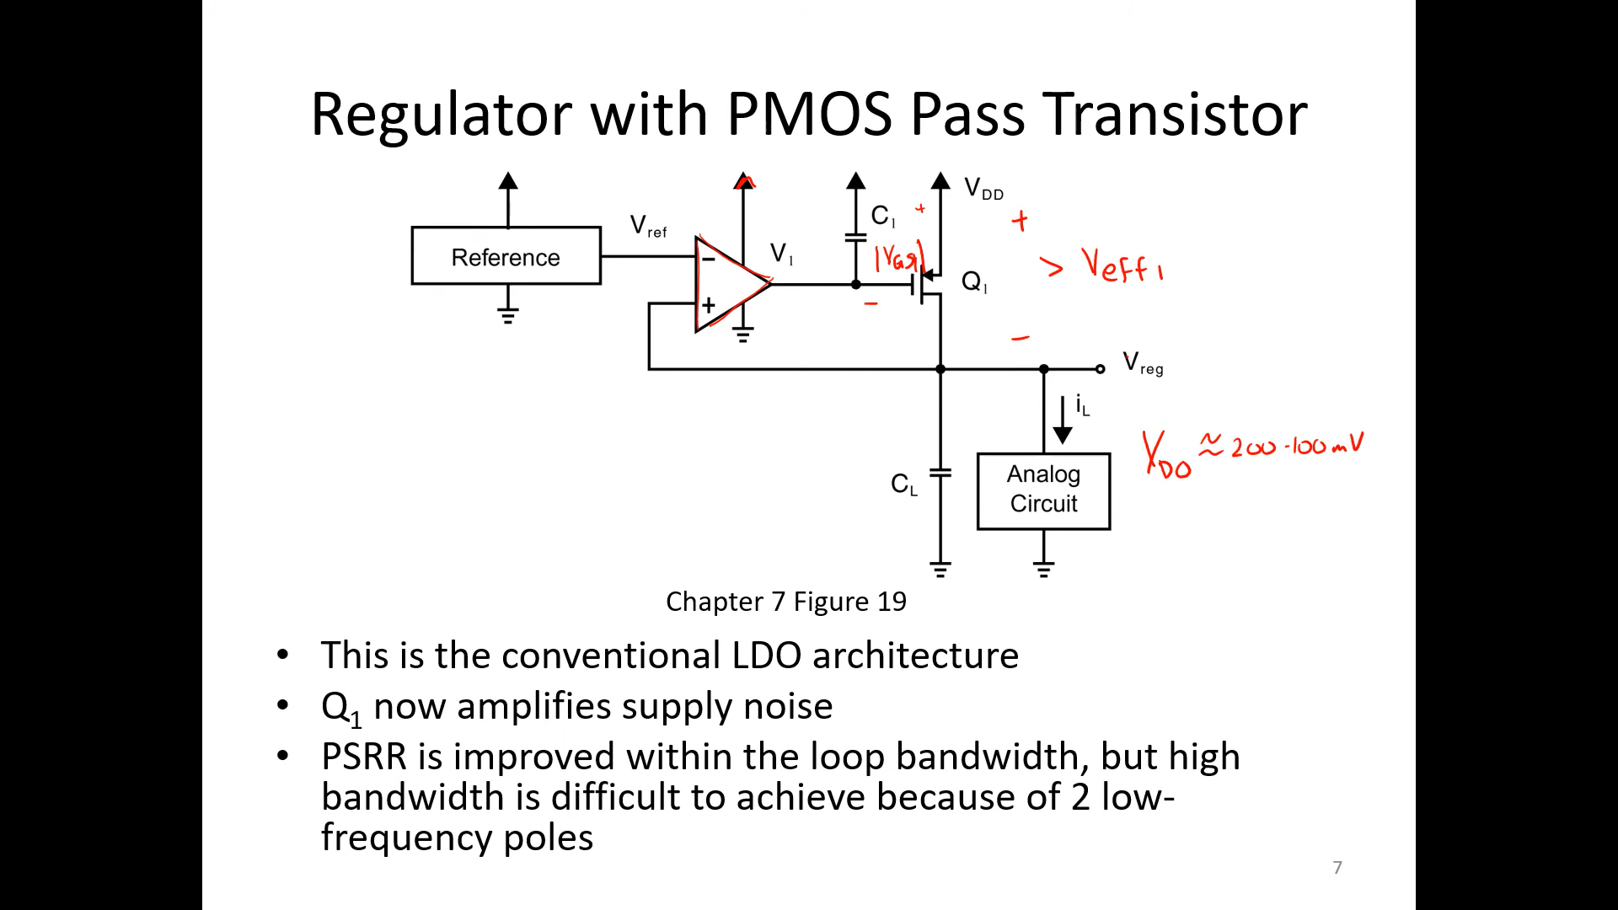

Slide 11
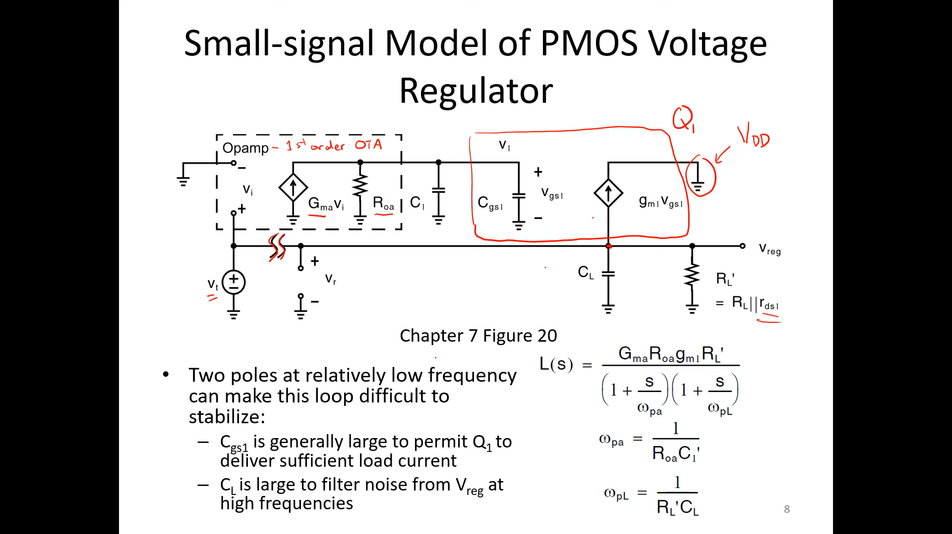
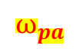

$$⍵_{pa}$$
$$⍵_{pL}$$

Slide 12
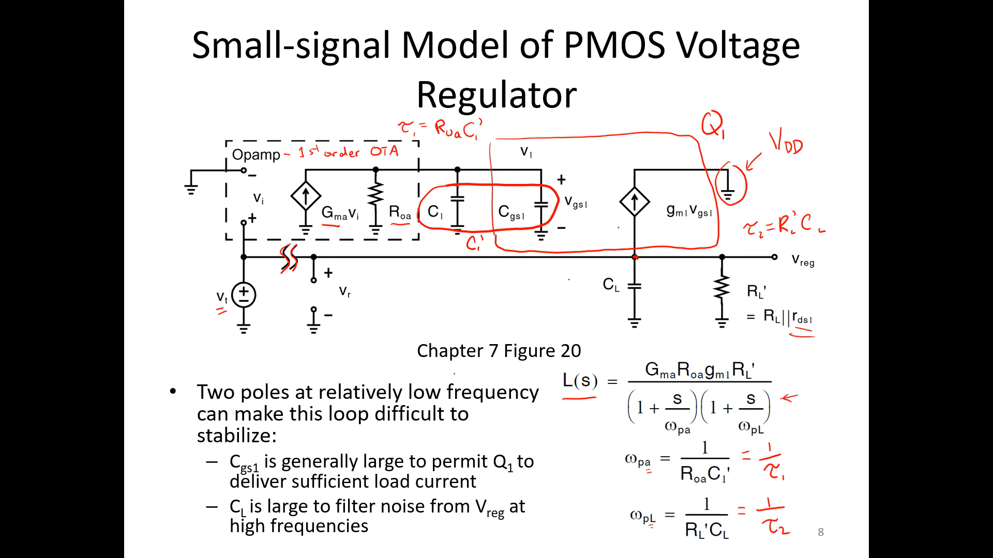
Break Loop + Add test voltage supply

Slide 13
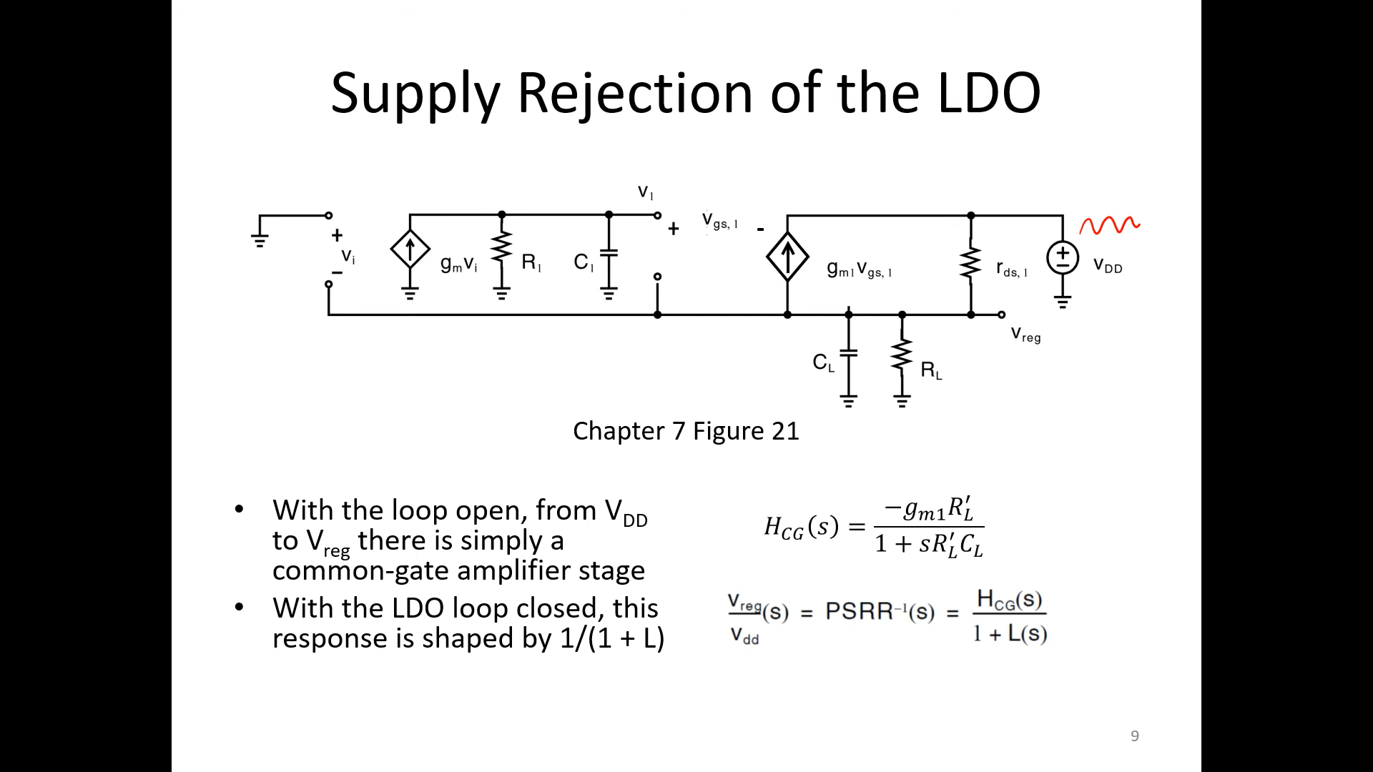
Add voltage supply

Slide 14
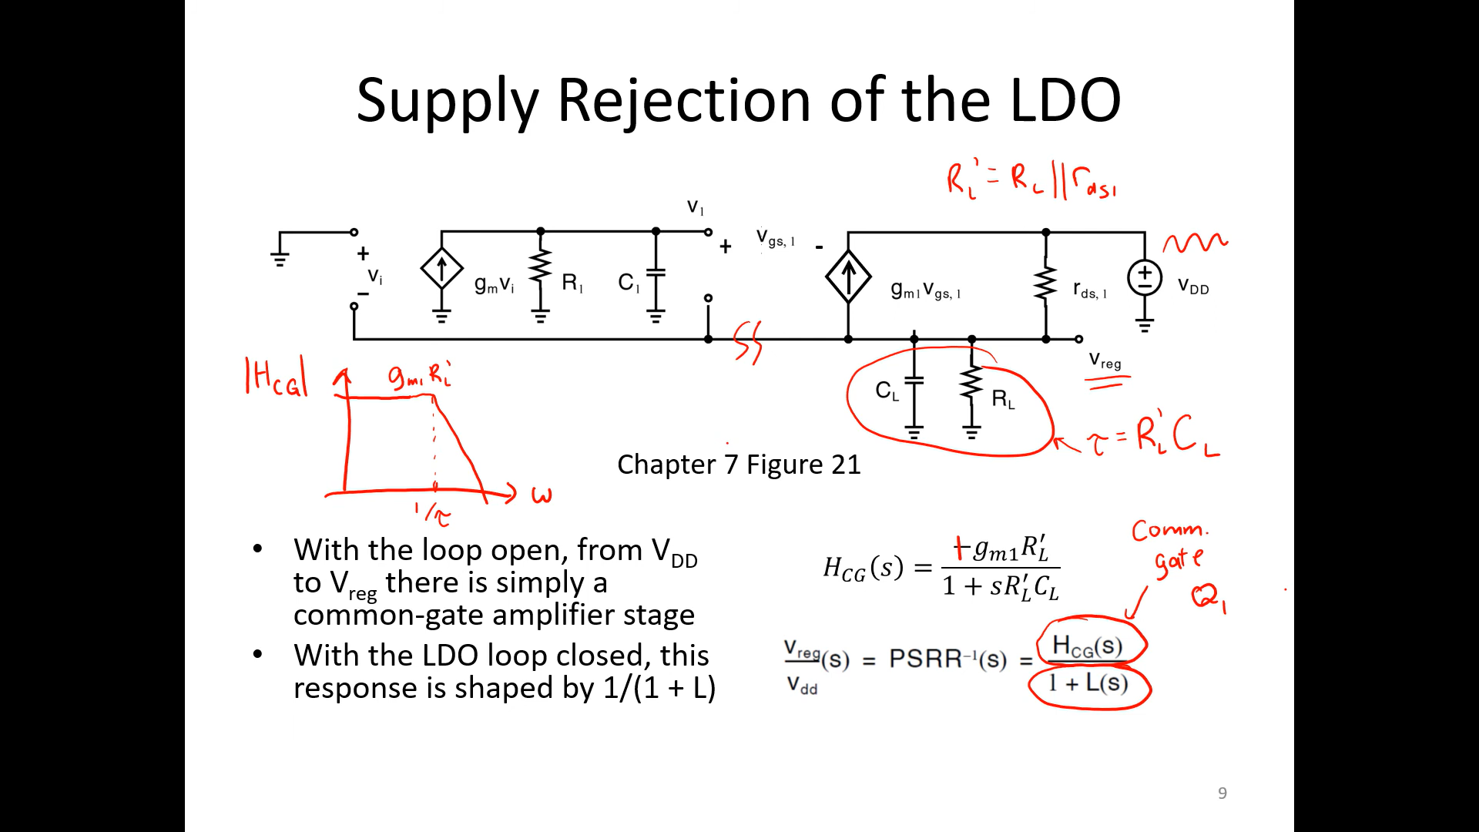
This gives gain (BAD)
We rely on L(s) to reduce the gain from input supply to vreg

Slide 15
